Slide 1
CPSC 351
Operating Systems Concepts
Processes

Slide 2







Still writing the program. Trust the Process!!
Yes, yes! I’m developing a program to start a process to get any kind of help
Robot 351, Get HELP!
Call 911!!
Is anyone coming?
It has been 35 minutes and 1 second and no one comes!

Slide 3
Agenda
Process Concept
Process Scheduling
Parent and Children

Slide 4
Process Concept

Slide 5

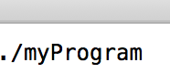


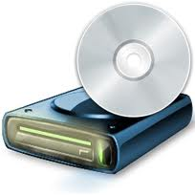
Process Review
A process can be defined as:
A program in execution
An instance of a running program
The entity that can be assigned to, and executed on, a processor
A unit of activity characterized by a single sequential thread of execution, a current state, and an associated set of system resources
myProgram process in execution
myProgram
(executable)
myProgram’s instructions
Memory
CPU, memory, I/O devices
Notes:
Program is passive entity stored on disk (executable file), process is active
Program becomes process when executable file loaded into memory

Slide 6
Process in Memory
A process is more than the program code
Includes
Current activity such as program counter (PC specifying the next instruction to execute) and contents of processor registers
Stack: stores function parameters, local variables, and return address
Heap: contains dynamic memory allocated during process runtime
Data: contains global variables
Text: stores the program instructions (i.e., the executable)
Stack
max
Heap
Data
Text (i.e. binary)
0

Slide 7
Process in Memory Example
int a = 1;
int f(int c) { int b = c+1; return b;}
int main()
{ int d = 2;
char* arr = new char[100];
for(int i = 0; i < 100; ++i)
arr[i] = ‘\0’;
f(d);
delete arr;
return 0;
}
Stack
Data
max
Heap
Stack
Heap
Data
Text (i.e. binary)
0
Text (i.e., executable instructions)

Slide 8
One Program Two Processes
Stack
≠
Stack
(vary)
Heap
≠
Heap
Data
≠
Data
Text (i.e. binary)
=
=
Text (i.e. binary)
aProgram
aProgram’s process 1
(equivalent)
aProgram’s process 2
Notes:
User may run different copies of Word program

Slide 9
Process State
Terminated
Creation Complete
New
Execution Interrupted
Running
Execution Complete
Ready
The event we were waiting for has happened (e.g. I/O completed)
Assigned to CPU
Need to wait for an event (e.g. I/O to complete)
Waiting
The states of a process:
New: The process is being created
Ready: The process is waiting to be assigned to a processor
Running: Instructions are being executed
Waiting: The process is waiting for some event (e.g., I/O completion)
Terminated: The process has finished execution
Notes:
State names are arbitrary, vary across OS
States that they represent are found on all systems
Only one process can be running on any processor at any instant. But many processes may be ready and waiting to be executed.

Slide 10
Process States in Linux
Use the ps utility to learn process state in Unix:
Example: ps –aux
Interpreting the output of ps
R the process is running or runnable (on run queue)
D uninterruptible sleep (usually I/O)
S interruptible sleep (waiting for an event to complete)
Z defunct/zombie, terminated but not reaped by its parent (discussed later)
T stopped, either by a job control signal or because it is being traced
T
Process is paused, e.g., using Ctr+Z
Process is woken up, e.g. using fg cmd
I/O operation completes
D
R
Z
Process terminates
I/O operation
The event completes
Process must wait for an event to complete
S
Notes:
User hits ^z while the process is in the foreground, then types fg to send CONT signal to continue the process

Slide 11
Process Control Block
OS uses a Process Control Block (PCB) to represent each process
PCB Components:
Process State: the state of the process, e.g., running, waiting, …
Process ID: a unique ID associated with the process, e.g., 1234567
Program Counter: the address of the next instruction to be executed
CPU Registers: the current values of the accumulators, stack pointers, etc…
CPU-Scheduling Information: process priority and other info needed for assigning the process to the CPU
Process State
Process ID
Program Counter
Registers
Scheduling Info
Memory Limits
Open Files
…
Notes:
Chapter 6 describes process scheduling

Slide 12
Process Control Block (cont)
OS uses a Process Control Block (PCB) to represent each process
Memory Management Information: info about memory allocated to the process
Accounting Information: CPU used, clock time elapsed since start (e.g., how long the process was running), time limits, …
I/O Status Information: list of I/O devices used by the process, list of open files, etc…
Process State
Process ID
Program Counter
Registers
Scheduling Info
Memory Limits
Open Files
…
Notes:
Chapter 6 describes process scheduling

Slide 13
Process Representation in Linux
In Linux OS, C structure task_struct in <linux/sched.h> is used to represent PCB
pid t_pid; /* process identifier */ long state; /* state of the process */ unsigned int time_slice /* scheduling information */ struct task_struct *parent; /* this process’s parent */ struct list_head children; /* this process’s children */ struct files_struct *files; /* list of open files */ struct mm_struct *mm; /* process address space (memory info) */

Slide 14
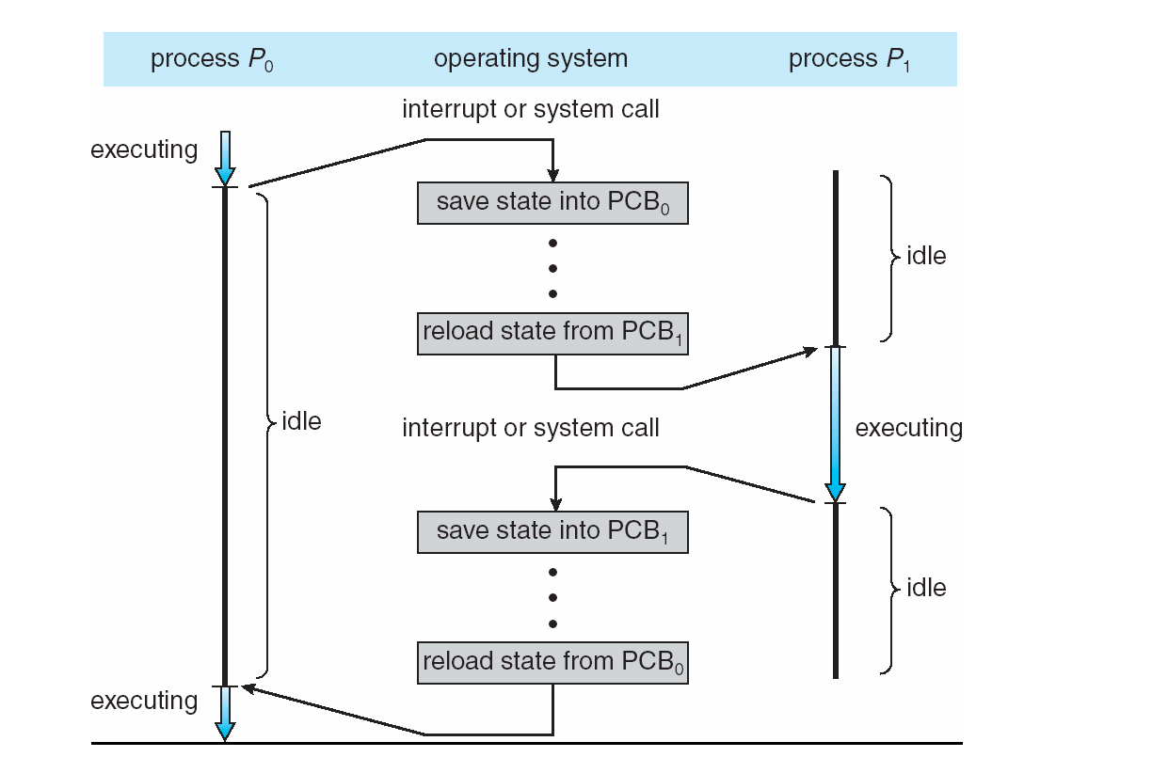
PCB Usage
CPU switch between process P₀ and process P₁

Slide 15
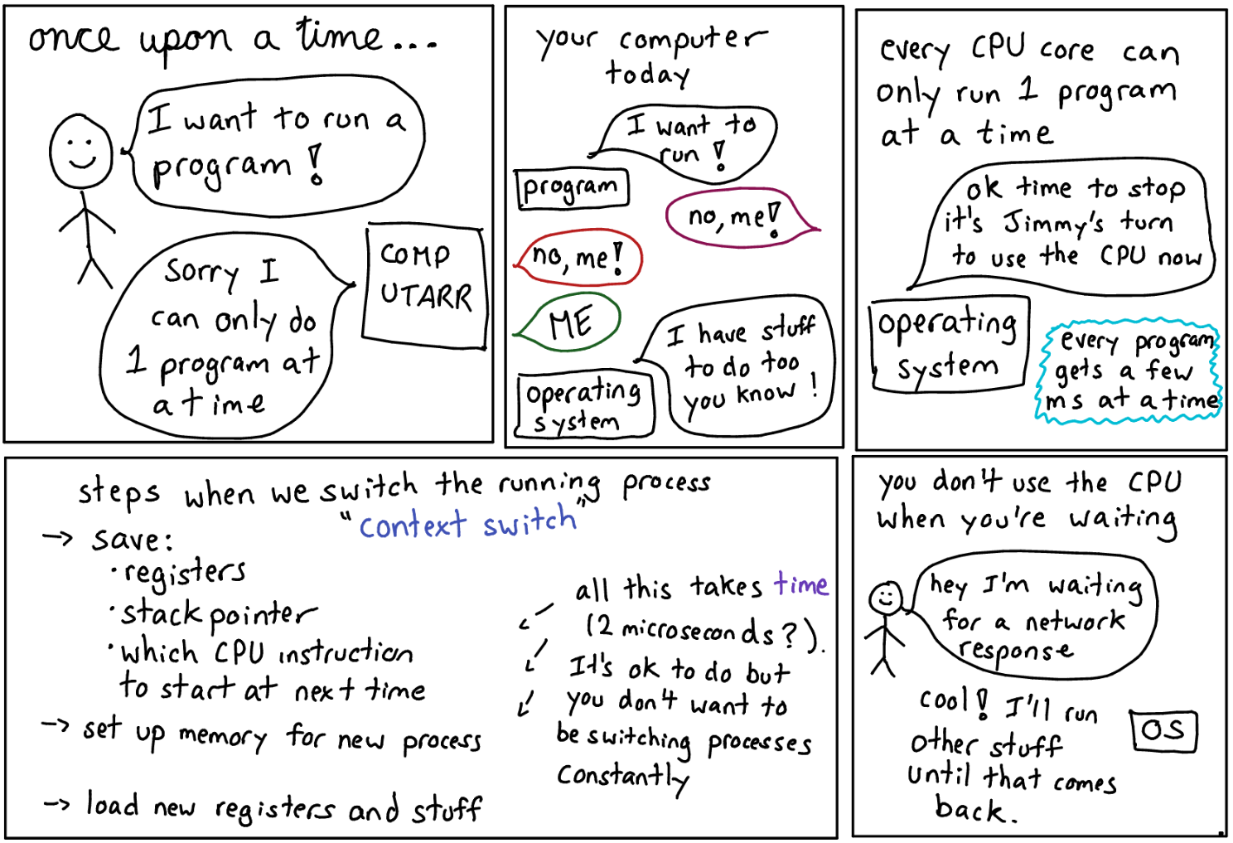
Process Scheduling

Slide 16
Process Scheduling -The Queuing Mechanism
Objective of multiprogramming
Have some process running at all times to maximize CPU utilization
Objective of time sharing
CPU switches processes frequently to allow users interact with each running program
Solution
Use a process scheduler to decide which available processes get the CPU
Process scheduler consists of
Job queue: contains all processes on the system
Ready queue: contains processes that are in the main memory and are ready to execute
Device queue (1 per device): contains all processes waiting to use a particular device
Notes:
- When processes enter the system, they are put into a job queue
- Processes that are residing in main memory and are ready (waiting for execution) are kept on the ready queue (a linked list)

Slide 17
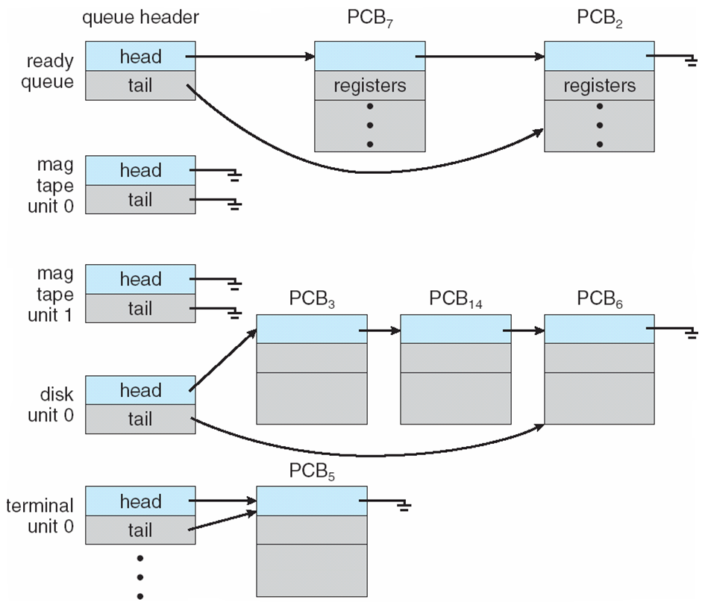
Ready Queue and Various I/O Device Queues

Slide 18
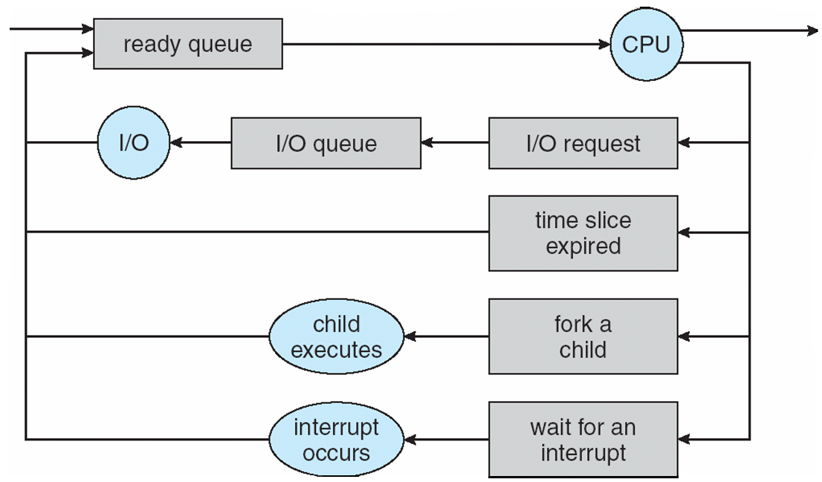
Process Scheduling: The Queuing Mechanism in Action
1. New process is placed on a ready queue
2. The process is dispatched, i.e., selected for execution
3. During execution:
Process may be queued on the device queue due to an I/O request
Process can create a new subprocess and wait for its termination
Process can be interrupted and removed from the CPU
Process time slice (i.e., time allotted for its CPU use) expires:
Process is removed from the CPU
is placed on the ready queue until scheduled to run for another time slice
Boxes = queues
Circles = resources that serve the queues /
actions

Slide 19
Process Scheduling: Schedulers
Assigning processes to queues and selecting processes for execution, is the job of a process scheduler
Types of schedulers:
Short-term decides which process in memory gets the CPU
Invoked very frequently (often at least once every 100 msecs)
Has to be efficient
Long-term
Medium-term

Slide 20
Process Scheduling: Long-term Schedulers
What if there are more processes than can fit into memory?
Solution: Temporarily store / spool some processes on a mass storage device, e.g., hard drive
Long-term Scheduler selects spooled processes to load from the mass storage device into main memory
Executes less frequently than a short-term scheduler
Key idea: maximize resource utilization by selecting a mix of CPU bound and I/O bound processes
I/O bound processes are processes that spend more time doing I/O operations than CPU computations
CPU bound processes are processes that spend more time doing CPU computations than I/O operations
Rational:
If all selected processes are I/O-bound, then ready queue will always be empty i.e., nothing to execute on the CPU!
If all selected processes are CPU-bound, the device queues will be empty i.e., the devices go unused
Not all systems such as UNIX and Windows have long-term scheduler

Slide 21
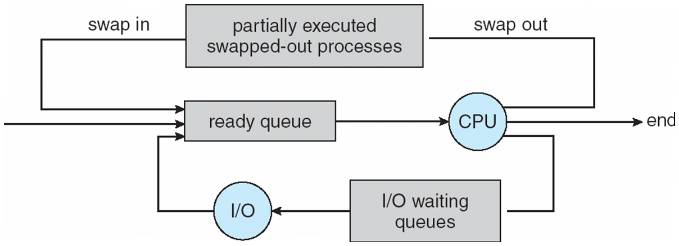
Process Scheduling: Medium-term Schedulers
Removes some processes from memory in order to improve the process mix
Later, the removed processes can be brought back into memory
The job of the medium-term scheduler is also known as swapping

Slide 22
Process Scheduling: Context Switching
Switching CPU between processes:
1. Save CPU state of the currently executing process into a PCB
2. Select another process
3. Use the saved PCB of the selected process to initialize the CPU
4. Let the selected process resume execution
Context switch time is pure overhead!

Slide 23
Parent and Child Processes

Slide 24
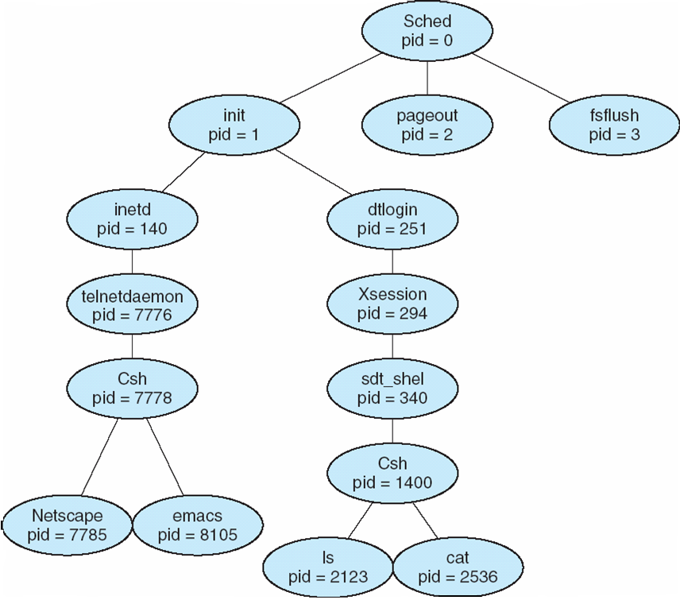
Operations on Processes
A process may create new processes by issuing a process creating system call ➔ asking the OS to create another process
Parent process: the creator process
Child process: the process created by the parent process
Child processes can create their own child processes
Process tree: a model of parent-child relationships
Process tree on a typical Linux system

Slide 25
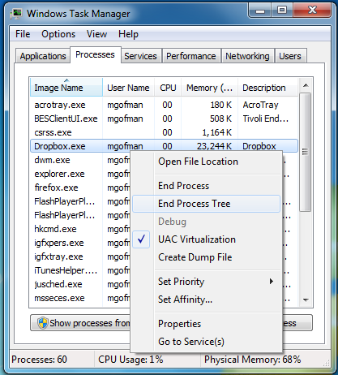
Operations on Processes: Windows Process Tree Example
Windows: “End Process Tree” terminates the selected process and all its descendants

Slide 26
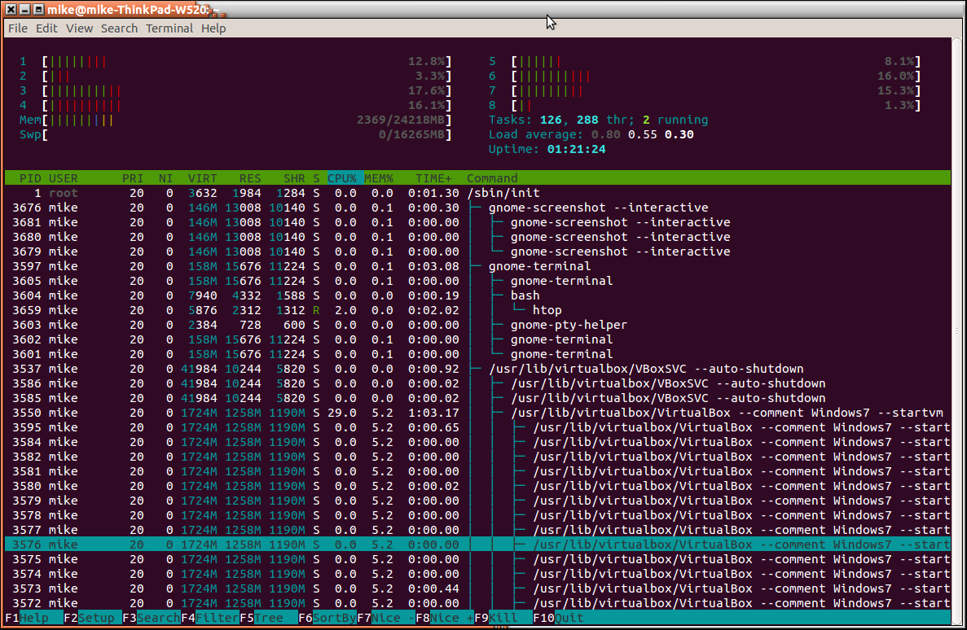
Operations on Processes: Linux Process Tree Example
Process displayed using the “htop” program

Slide 27
Operations on Processes: Parent-Child Relations
After creating a child process a parent process may:
continue executing, or
wait for the child process to terminate
The child process can either:
be a duplicate of the parent process (i.e., has the same program and data), or
it may be running a new program

Slide 28
Next Week
More on process creation
Inter-process communications
C Coding Assignment Due
Process Assignment

Slide 29
References
Operating System Concepts, 9th Edition, Abraham Silberschatz, Peter Baer Galvin, Greg Gagne
Chapter 3

